Slide 1
CD in the Enterprise

Slide 2
Continuous Delivery/Deployment
Two extensions of CI
Similar to CI and each other, but are distinct
Continuous Delivery
Automated push to staging environments
Just requires human approval before full deployment
Continuous Deployment
Deployment from development to live environment is fully automated
New human approval necessary

Slide 3
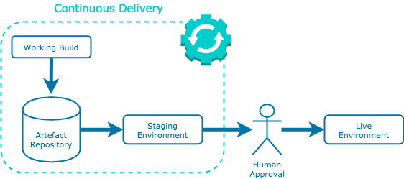
Continuous Delivery
while CI integrates code regularly, continuous delivery also delivers that code regularly
automated process in place such that new releases only require approval via a click of a button to go live
encourages organisations to deploy their applications as early as possible in smaller batches

Slide 4
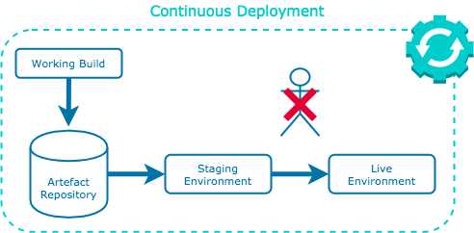
Continuous Deployment
Further extends the continuous delivery practice such that feature releases are entirely automated
no human interaction for new application features to end up in the customer's hands
benefit of eliminating the idea of a "release date" – developers can focus on creating new ideas without time constraints

